Slide 1

Welcome to PS188Q!
Kindergarten
Orientation

Slide 2
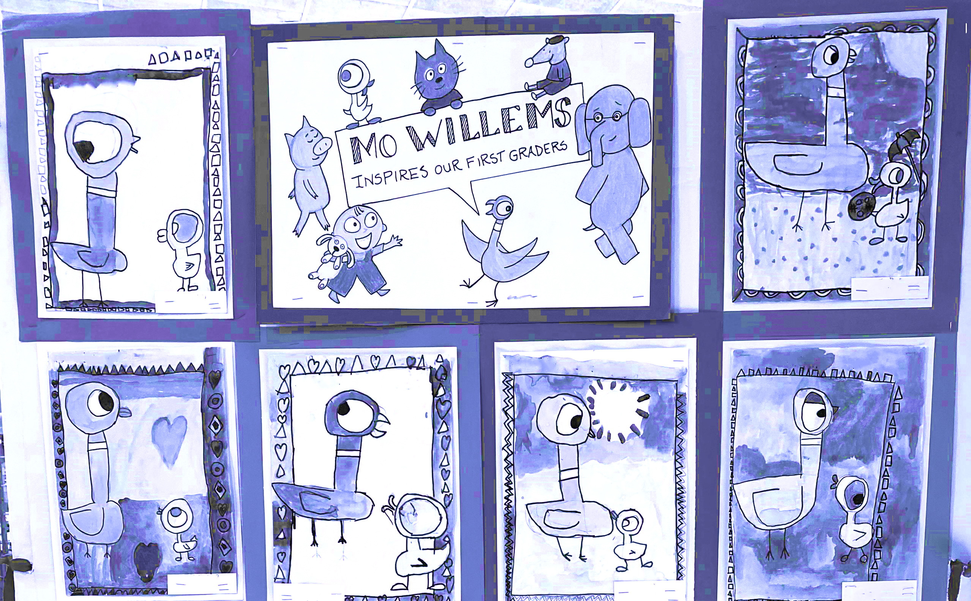
Kindergarten Parent Orientation Agenda
Welcome!!
  Introduction
    Mrs. Figueroa, Principal
    Mrs. Nartowicz, Asst. Principal
  Cluster Classes
    Music
    STEM
    PE/Gym
    Art
  Supply List
  Technology
  The 1st Day of school is Thursday, September 4th and it is a full day for all children.
  Parking Lot
  Your child’s day – Mrs. Nartowicz, Asst. Principal
    Early drop-off begins at 7:35am
    Breakfast
    Arrival is at 8:00 a.m. and dismissal begins at 2:15 p.m.
    Curriculum
    Lateness and Attendance
    Snack Time
    Lunch Time
      Lunch Forms
  Outdoor/Indoor Recess
    Volunteers – Lunchtime
  Dismissal
    Yellow Bus
    Pickup
    After School Pickup
    Bus- Zoned/GT
      Un-Zoned or GT Families
      Zoned Families
  PTA
    Committees and Volunteering
    Kindergarten Welcome Breakfast
  Nurse
    Medication 504
    Allergies
    Lice
  Communication/Email/Voicemail/Text/ Website/Calendar
    School Contact List
    NYCSA (NYC Schools Account)
    Student Email Address
  NYC Kids Rise Save for College Program – 529 Day
  After School Located in PS188’s Main Building
    Vacations

Slide 3
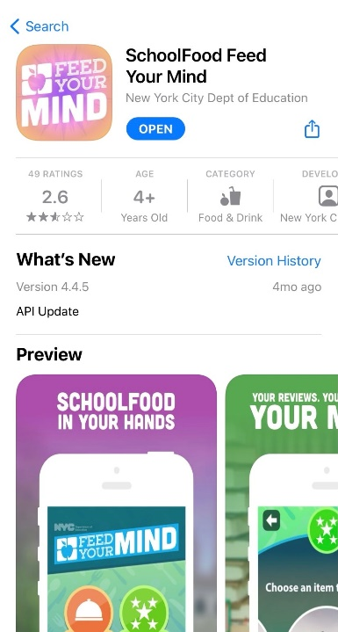


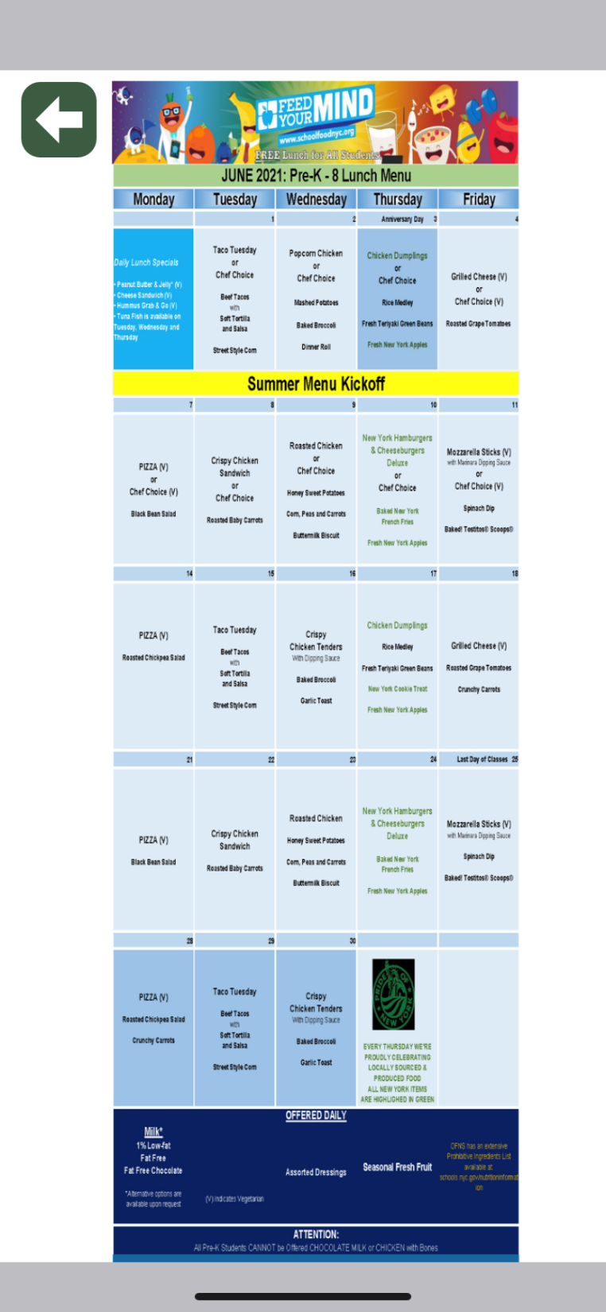
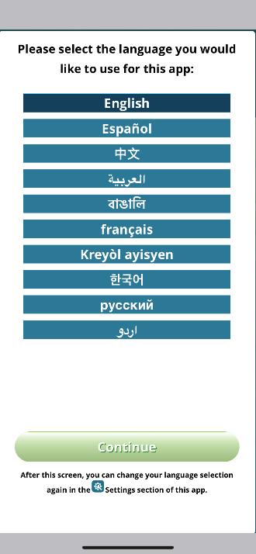

SchoolFood
Feed your Mind

Slide 4
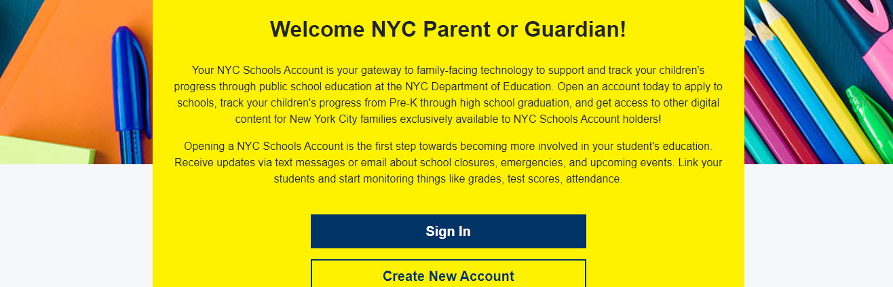
NYCSA

Slide 5
What Parents can do on NYCSA
Families can update and verify their emergency contact information via the Emergency Contact feature on their child’s NYCSA account. This can be found on the Enrollment Forms page.
See their child's grades, reading level, report card and assessments
Check attendance and lateness
See your child's NYCDOE email address and ID (OSIS) number
DOE highlights and notifications or reminders to fill out forms that have not been completed.
Stay Connected!
Families can reset their child’s NYCDOE email password directly from the NYCSA account.
Families will be able to fill out the Photo Consent Form online.
Kindergarten families will receive information on how to sign up and access NYCSA in mid to late September. A meeting will be held to assist families.

Slide 6
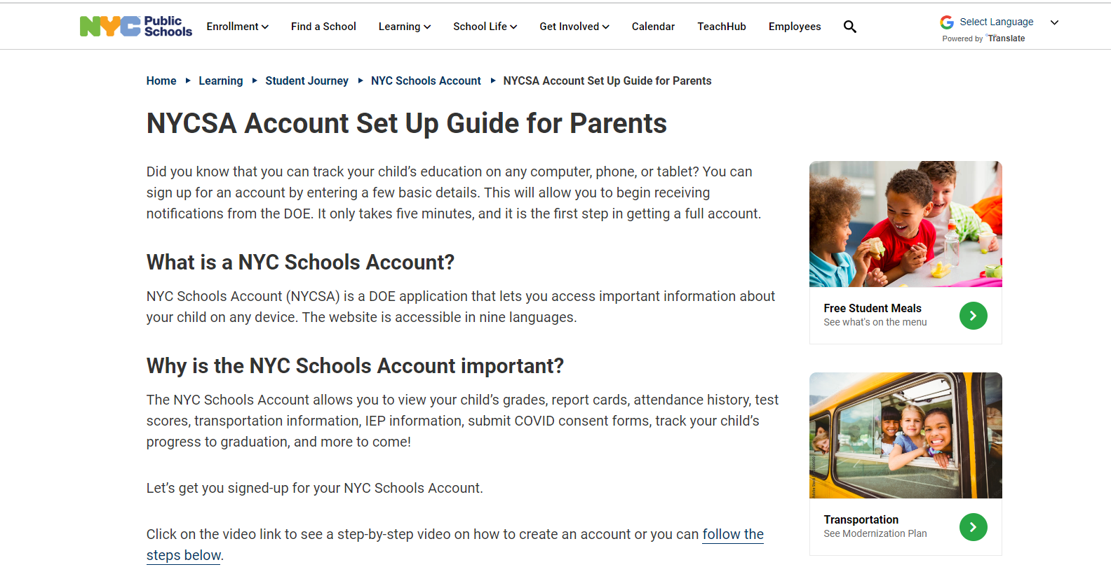
NYCSA Account Set Up Guide

Slide 7
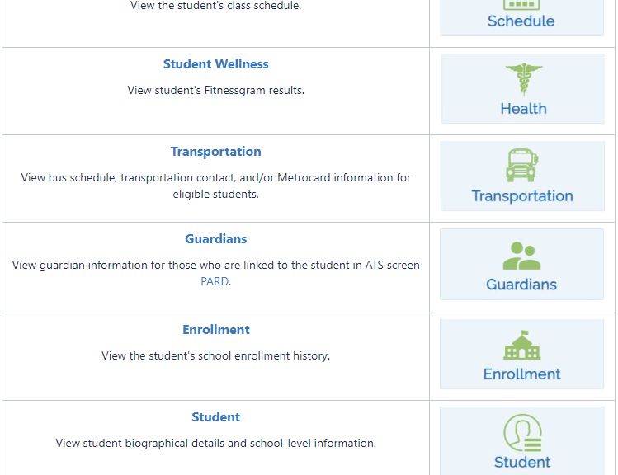
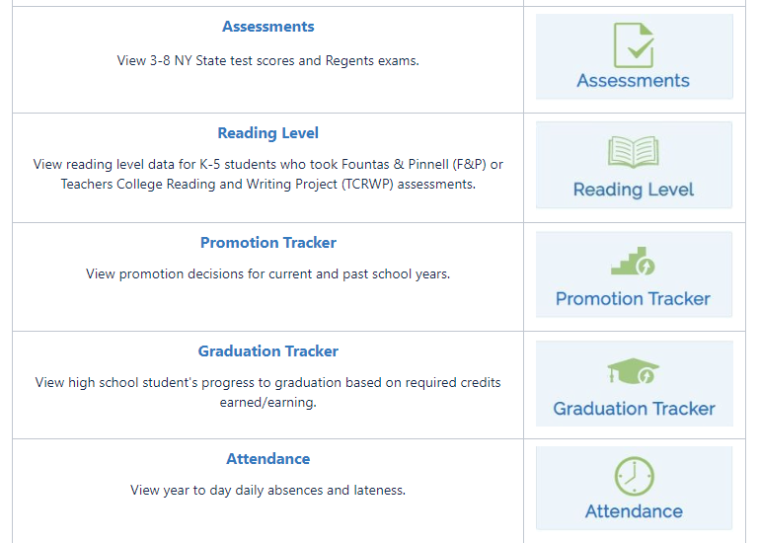
Here are the features families have on NYCSA.
  Attendance
  Assessments
  Reading Level
  Transportation
  Report Card
  Enrollment
  Guardians
  Student Information
Elementary School Families – Features such as, Promotional Tracker, Graduation Tracker and Schedule are primarily for middle school and high school families.

Slide 8
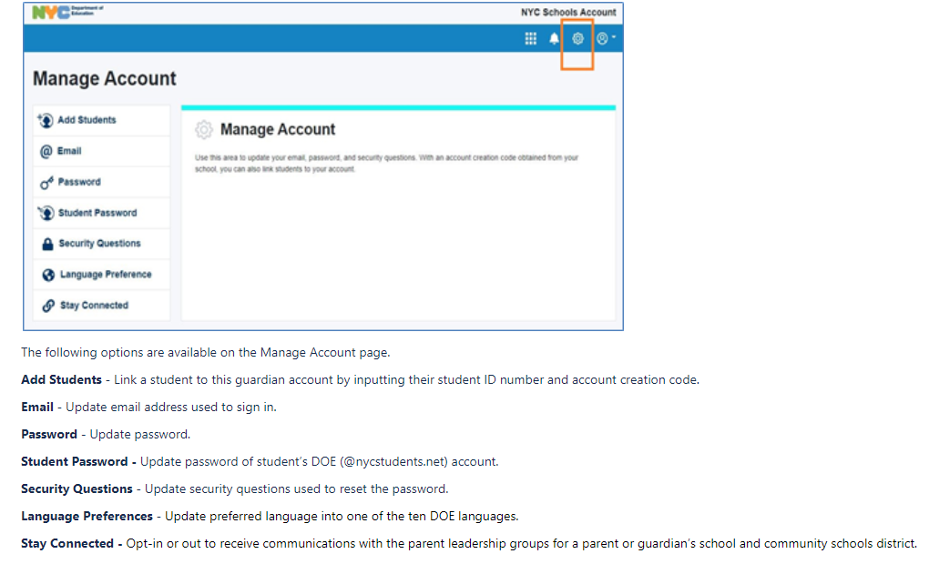

Slide 9
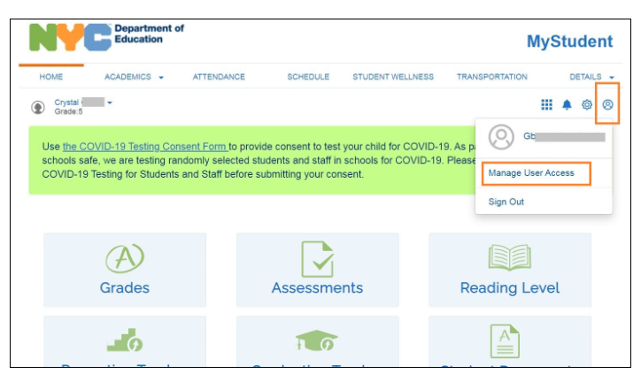
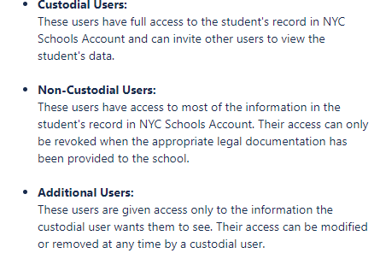
Custodial parents or guardians can choose to allow non-custodial users on the account such as a grandparent or relative. Please be mindful of who you are giving access too. There is a lot of personal information located on this site.

Slide 10
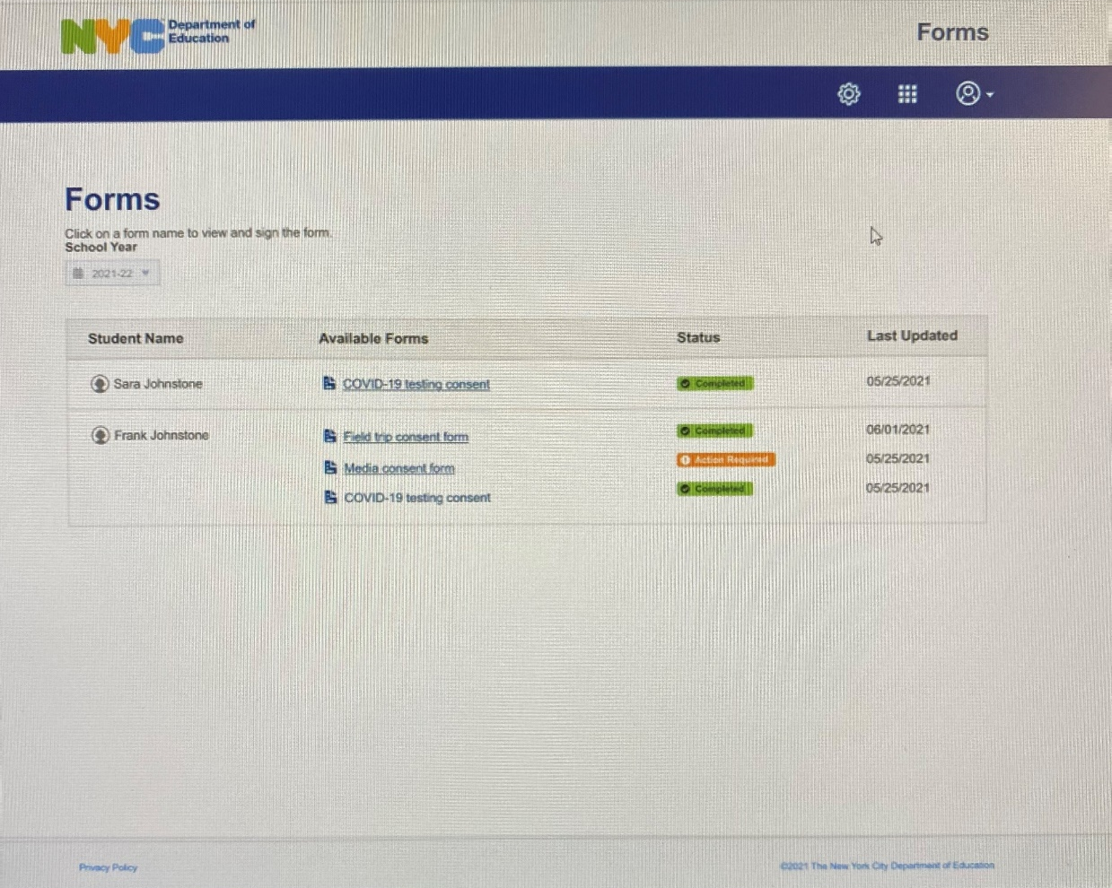
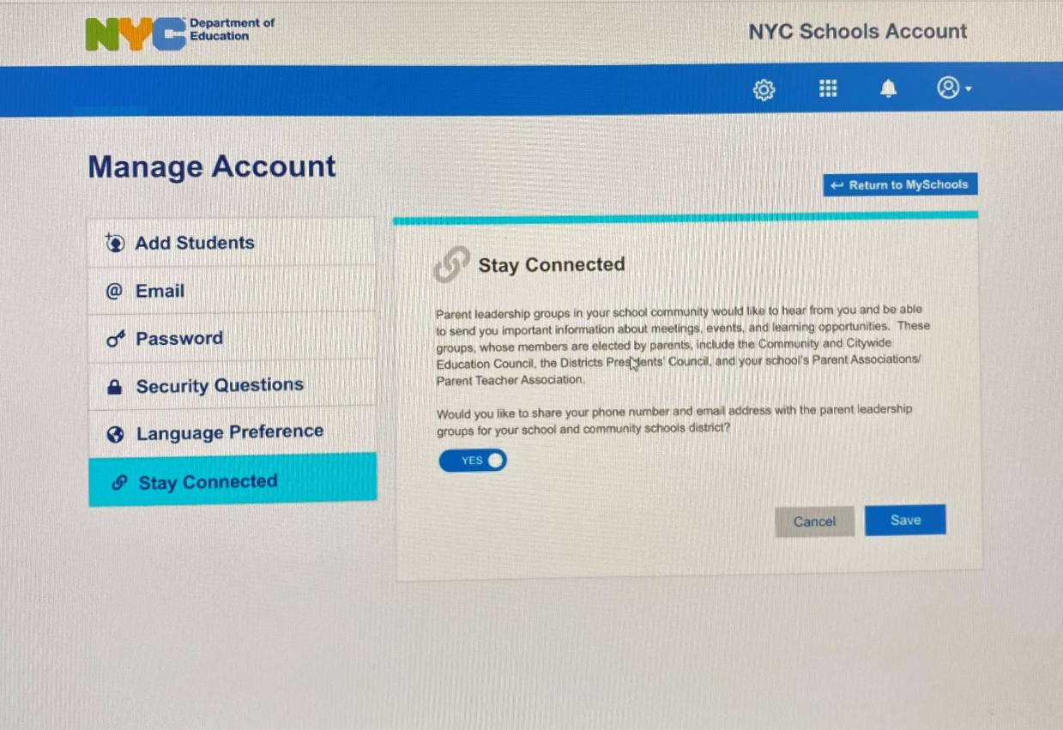
Parent/Guardian’s can opt into sharing their information with Parent Leadership groups such as CEC, CDEC, Presidents Council and the school’s PTA. Please consider signing up. This gives the PTA the ability to reach out to families directly with information on meetings and events.
Draft
Parent/Guardian can complete certain specific forms online

Slide 11
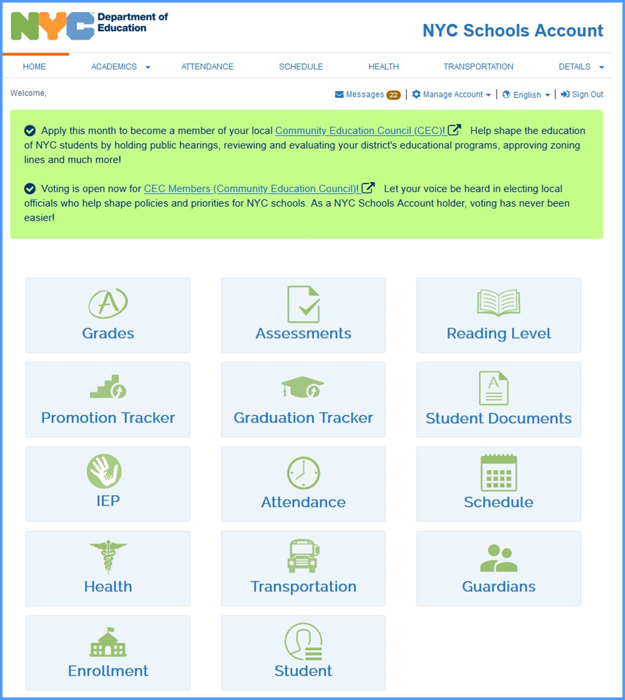
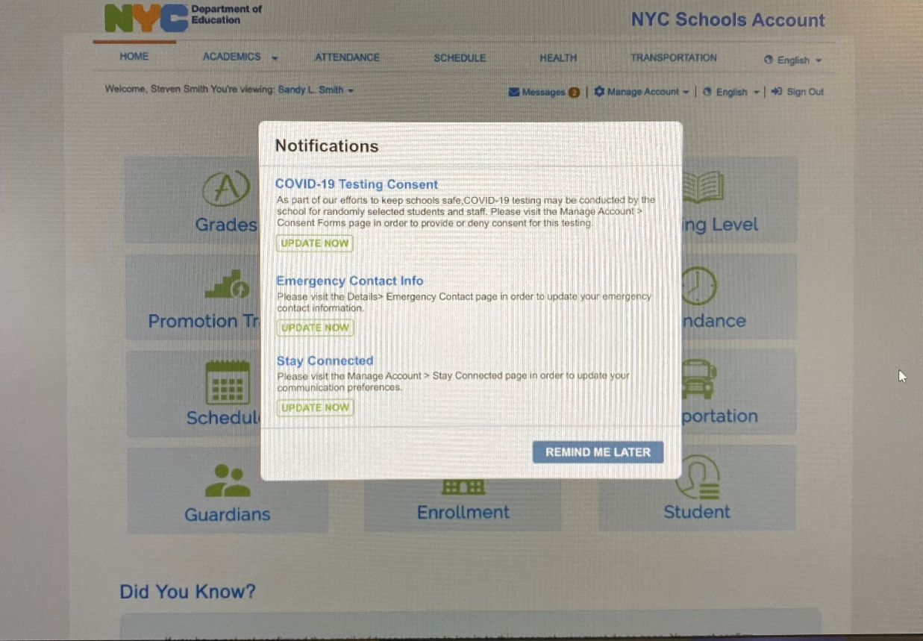
Parent/Guardians will get notifications of missing paperwork when they log in.

Slide 12
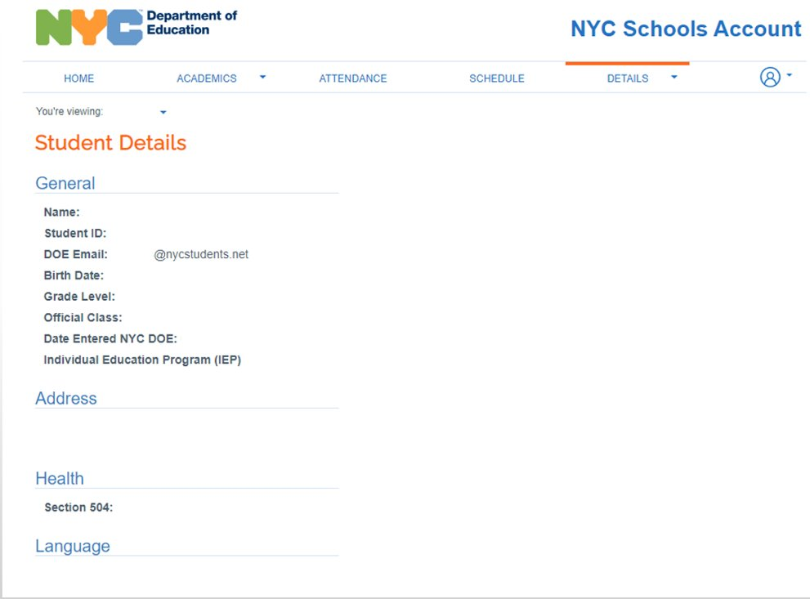

Slide 13

What is
NYC Kids Rise
The NYC Kids RISE Save for College Program is a scholarship and savings program designed to make college and career training more accessible for all NYC public school students— regardless of family income or immigration status.
In partnership with our nonprofit partner, NYC Kids RISE(Open external link), through the Save for College Program, every kindergarten student enrolled in a participating NYC public school automatically receives a NYC Scholarship Account with an initial $100 allocation on their behalf, unless their parents/guardians “opt out” of the program.

Slide 14
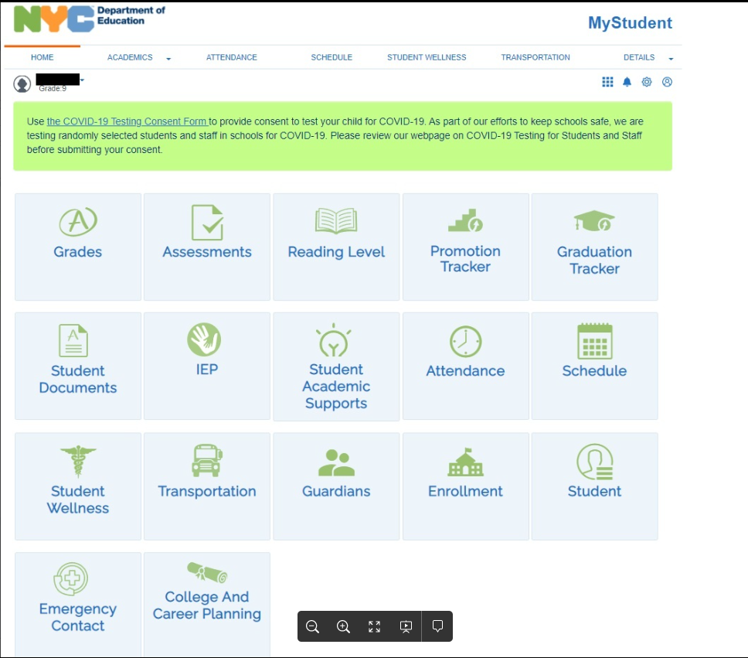

Slide 15
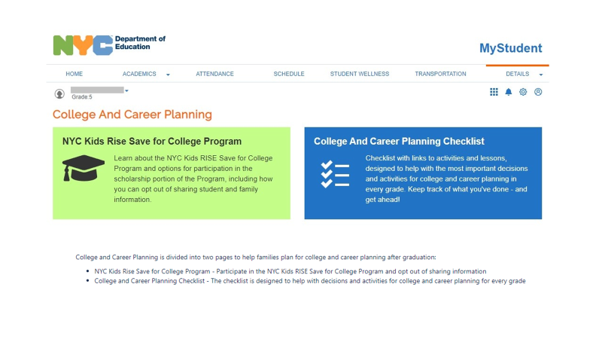

Slide 16
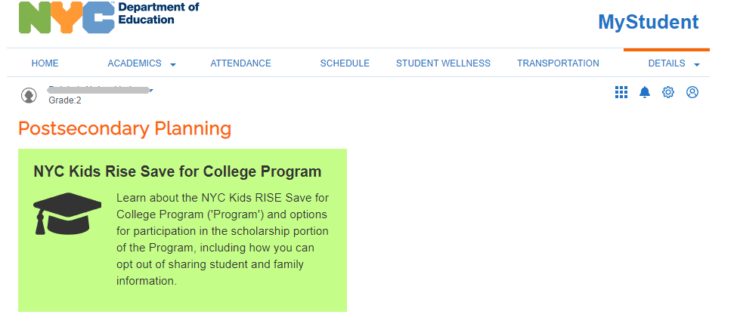

Slide 17
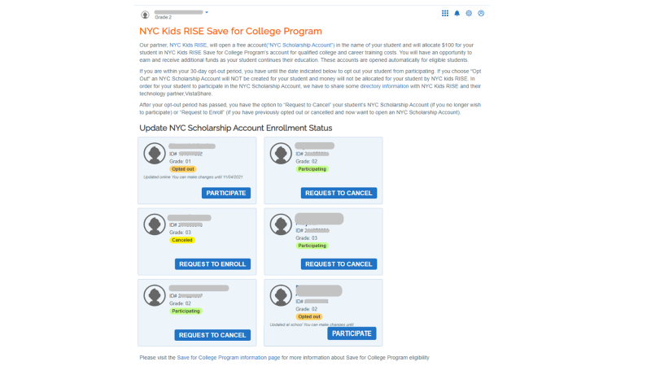

Slide 18
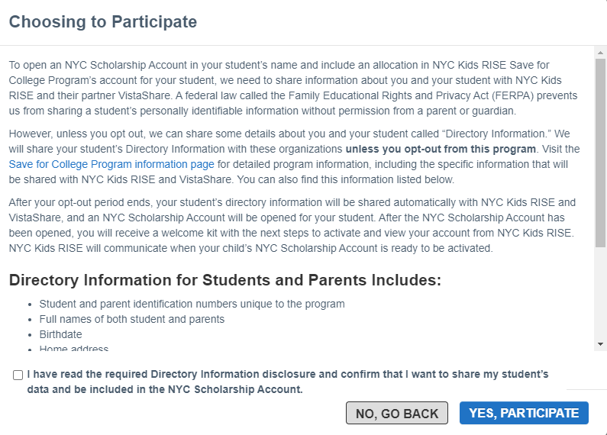

Slide 19
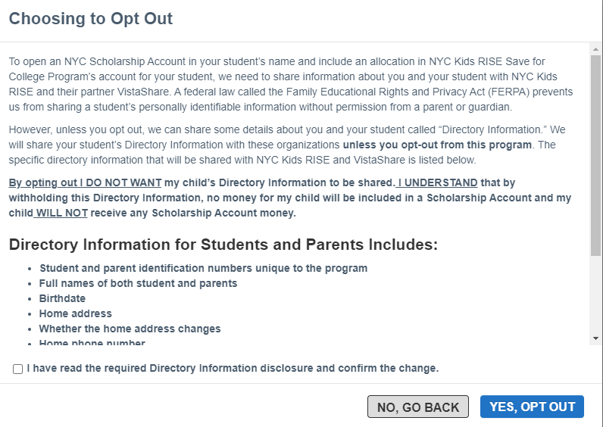

Slide 20

May 29th is 529 Day!
What is 529 Day?
This is a day when families are encouraged to consider creating a 529 account to start saving for their child's higher education.
What is a 529?
A 529 is a type of investment account that can be used for higher education.
Can a 529 be linked to the NYC Kids Save for College Account?
YESSS!! By creating a NYC Kids Save for College Account and following the building blocks, families can link there 529 to the account.
For more information on the 529 account click NY's 529!

Slide 21
For more information on NYCSA and NYC Kids Rise
Save for College Program, please follow the links below.
NYCSA
NYC Kids Rise Save for College - NYCDE Website

Slide 22
After School Programs Located in the Main building
Blueberry Children: Grades served Pre-K to 5th Grade.
This is a fee based program. Blueberry Children is held on the school premises. The program begins at the end of the school day and runs daily until 6:30 pm. Holiday and summer camp programs are available. Below is a brief description submitted by Mr. and Dr. Guha, owner and operator of the Blueberry Children After School Program. This is a fee-based program.
The Blueberry Children After-School Program has been designed by parents and educators. It is an intensive academic and non-academic enrichment program. Besides every day homework help, children are engaged in enhanced learning. The objective is to develop the whole child by nurturing the following dimensions of development- Physical, Cognitive. Emotional, and Social Skills. The program has a child-centric approach focusing on Integrated Curriculum. The academic programs are taught by educators, teachers. Master’s students and under-grad education majors. Sports activities are conducted by individual sports specialists.
For more information on the program and grades serviced please call (718)740-2424 or email at: blueberrychildrennewyork@yahoo.com.
MYAP- Multi Cultural Youth Arts Program Grades Served Pre-K-5th Grade
MYAP is an afterschool program designed to stipulate cultural recreational, and social activities with academic enrichment and homework our 1st priority.
Each day activities are instructed by our educated professionally uniformed staff. Our goal is to acquaint each child with something new and exciting every day. We invite parents to two showcases each year which display the progress of their children.
Dinning Etiquette, Dance, Sports, Chess, Drama, Debate, Foreign Language Instructional Clubs, Crocheting, Arts & Crafts, Movies, Library Trips, Cold Cooking, are just a small part of our program. We are constantly expanding the social outlets and opportunities that await each bright child.
We are available at P.S. 188 in the main building every full school day from dismissal until 6 :30 PM. We also offer a Holiday and Summer Day Camp that includes door to door pick up/ drop off transportation service. Please visit our website at WWW.MYAPINC.ORG , Email @myapinc@gmail.com, or call Deneille Loprete @ 917-414-3753 for information.

Slide 23
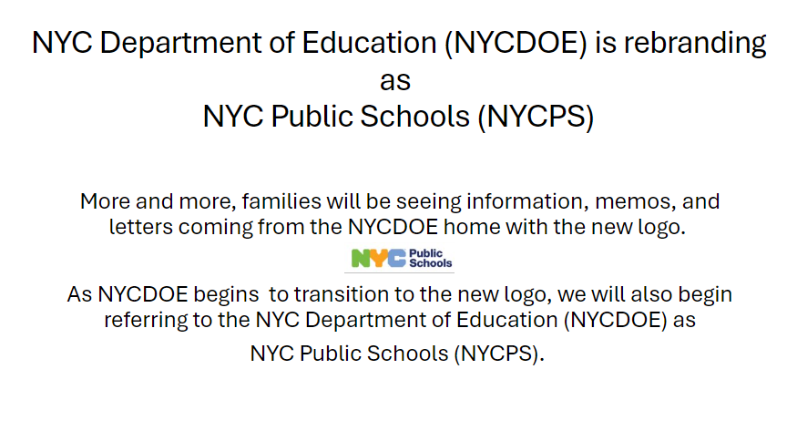

Slide 24
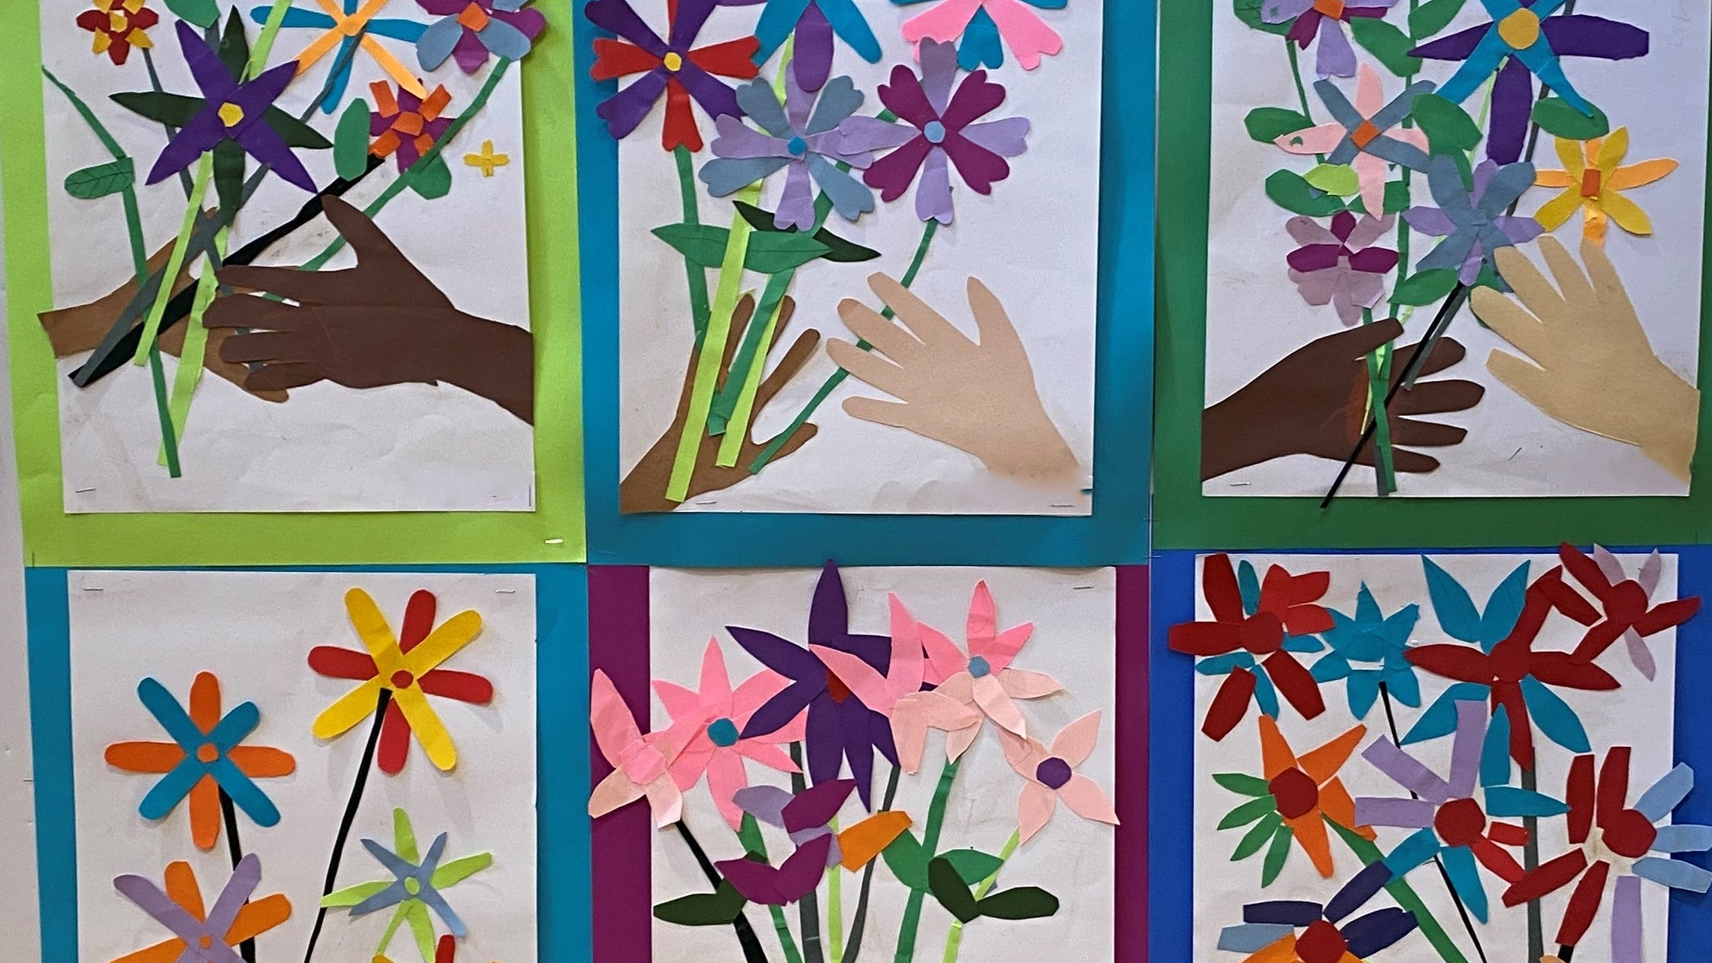
Questions

